Slide 1
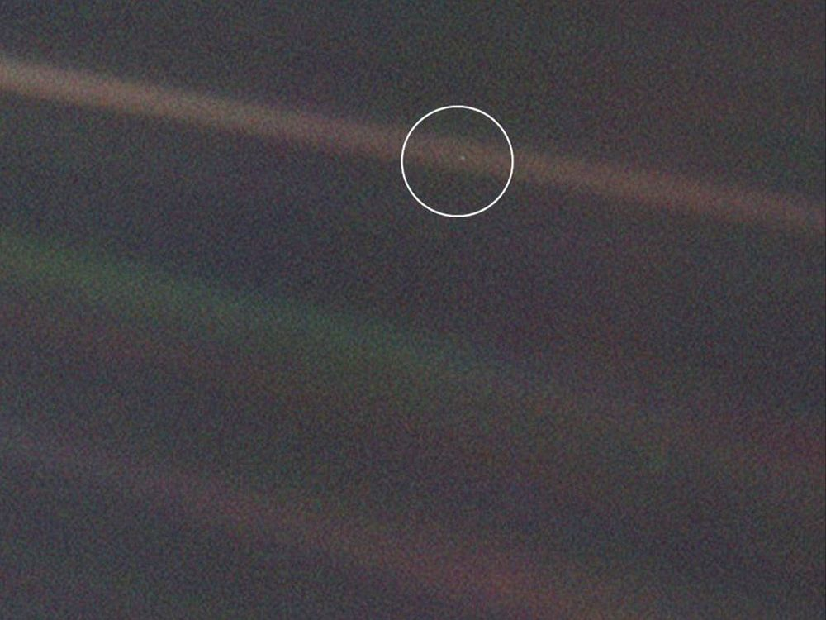
Pale Blue Dot is a photograph of planet Earth taken on February 14, 1990, by the Voyager 1 space probe from a record distance of about 6 billion kilometers, as part of the Family Portrait series of images of the Solar System.

Slide 2
Presently, the earliest known archaeological evidence of any form of writing or counting are scratch marks on a bone from 150,000 years ago. But the first really solid evidence of counting, In the form of the number one, is from a mere twenty-thousand years ago. An ishango bone was found in the Congo with two identical markings of sixty scratches each and equally numbered groups on the back. These markings are a certain indication of counting and they mark a defining moment in our civilization.¹

Slide 3
In Suma, around 4,000 BCE, the Sumerians ( present day Iraq) used tokens to represent numbers.
An advantage of using tokens to represent numbers is that in addition to adding tokens you can also take away, giving birth to arithmetic, an event of major significance.
The Sumerian’s tokens is of great importance in our society, because it made it possible to assess wealth, calculate profit and loss and to collect TAXes!!!!.
Keep permanent records.
This is the world’s first writings and accounting system.
In comparison: First step pyramid …....around 2800 BC

Slide 4
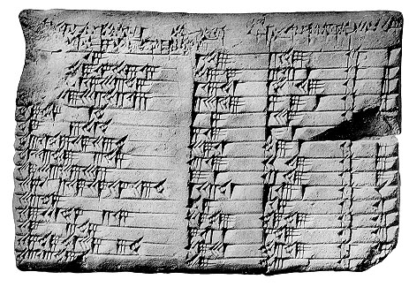

Around 1900 BC
The Babylonian number system.
The Babylonians ( present day Iraq) `wrote' on wet clay by pressing a stylus or wedge into it in one of a small number of ways. The Babylonian number system, already from a very early era, was remarkably sophisticated.
It was positional, They had to remember only 2 Symbols instead of ten and had the base ten without the zero.

Slide 5
Babylonian number system had a base of 60, inherited from the Sumerian and Akkadian civilizations, and possibly motivated by the large number of divisors that 60 has. The sexagesimal measurement of time and of geometric angles is a legacy of the Babylonian system.

Slide 6
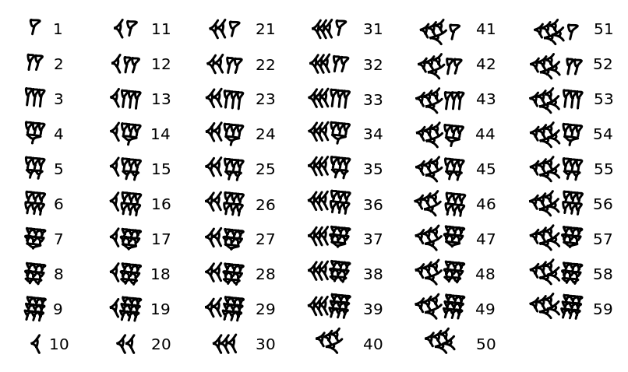

Slide 7














Number “1” was written with a single stroke `stroke'
Numbers 2 through 9 were written by combining multiples of a single stroke:
The number 10 was written in a single character
For example, 11 was written
20 30 40 50

Slide 8
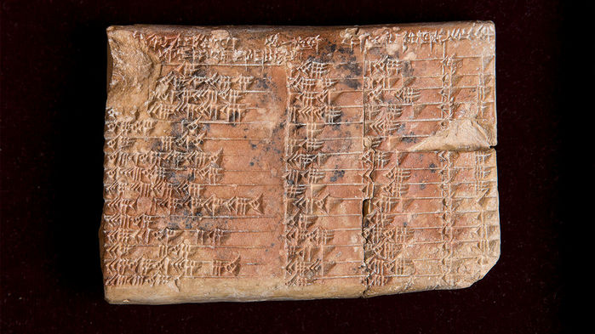
1500 BCE The Babylonians invented trigonometry. The cuneiform inscriptions on
Plimpton 322 suggest the Babylonians used a form of trigonometry based on the
ratios of the sides of a triangle rather than the more familiar angles, sines, and cosines.

Slide 9
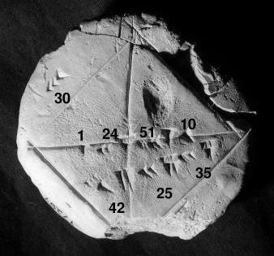
Babylonian tablet YBC 7289 showing the sexagesimal number 1;24,51,10 approximating √2
YBC Yale Babylonian Collection

Slide 10
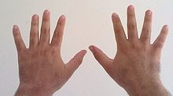
The ten fingers on two hands, is a possible starting point of the decimal counting as observed with children.

Slide 11
Decimal notation is a base 10, positional notation. It is the Hindu-Arabic numeral system.
The Non-positional systems such as Roman or Chinese numerals are also based on powers of ten.

Slide 13
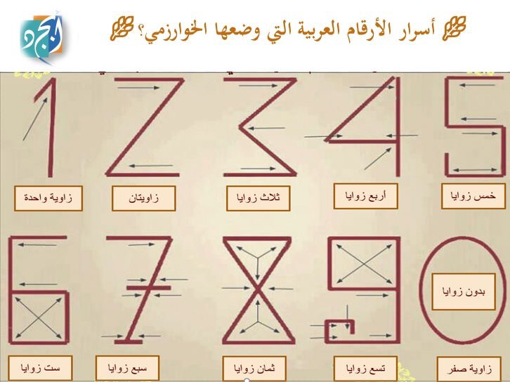

Slide 14
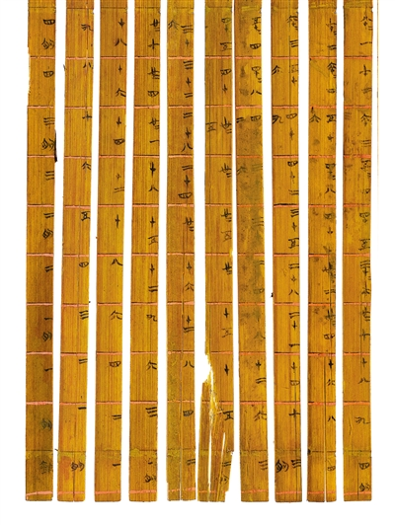
The world's earliest decimal multiplication table was made from bamboo slips, dating from 305 BC, during the Warring States period in China.

Slide 16
Positional system , Decimal,
The base or Radix is 10, The number is presented as:
10^{n} A_{n} + 10^{n-1} A_{n-1} + 10^{n-2} A_{n-2} +.......... + 10¹A₁ + 10⁰ A₀
Example:
A number such as 3471 is written as
10³ . 3 + 10² . 4 + 10¹ . 7 + 10⁰ . 1
Normally the coefficients are written and the positions are assumed.
More general:
10^{n} A_{n} + 10^{n-1} A_{n-1} + 10n-² A_{n-2} +.......... + 10¹A₁ + 10⁰ A₀ . 10-¹A-₁ + 10⁻² A-₀ .....
decimal point

Slide 17
Positional Binary numbers,
The base or radix is 2, so there is only two numbers 0 and 1
↓
2^{n} A_{n} + 2^{n-1} A_{n-1} + 2^{n-2} A_{n-2} +.......... + 2¹A₁ + 2⁰ A₀
Example:
A number such as 1101 (13₁₀) is written as:
2³ . 1 + 2² . 1 + 2¹ . 0 + 2⁰ . 1
8 + 4 + 0 + 1 =13₁₀
Normally the coefficients are written and the positions are assumed.
More general:
2^{n} A_{n} + 2^{n-1} A_{n-1} + 2n-² A_{n-2} +.......... +2¹A₁ + 2⁰ A₀ . 2-¹A-₁ + 2⁻² A-₀ .......
binary point

Slide 18
Common number systems that we might need:
Binary base = 2
Octal base =8
Decimal base =10
Hexadecimal base =16

Slide 19
Binary Prefixes or symbols
The prefix represents the power of 1000, and means 10^{n}
2 ¹⁰ Kilo or K =1,024 bits or , 10³
2²⁰ Mega M =1,048,576 bits or 10⁶
2 ³⁰ Giga G = 1,073,741,824 bits or 10⁹
2⁴⁰ Tera T= 1,099,511,627,776 bits or 10 ¹²
2 ⁵⁰ Petabyte ( app 1 000 000 000 000 000 bytes) or 10¹⁵
^{Exabyte (}2 ^{60 ), Yottabyte (} 2 ^{70) , Xenottabyte (}2 ^{80) ,}
^{Shilentnobyte (}2 ^{90) , Demengemgrottebyte (}2 ^{100 )….......}

Slide 20
Weight of the digital information storage
1 bit: A binary decision
1 byte: A single character,, (8 bits)
10 bytes: A single word
1 K Byte: A paragraph
2K Bytes A page
100 K Bytes: A very low resolution Photograph
1 M Byte: A small Novel
2 M byte: A high resolution Photograph
5 M byte: A complete works of Shakespeare
10 M byte: A minute of High fidelity sound
100 M bytes: A meter of Shelfed books
800 M bytes: A CD-ROM
1 Giga Bytes: A pick up truck filled with paper
20 G Bytes: A good collection of works of Beethoven
1 Tera byte : 50,000 trees made into printed paper
10 Tera bytes: The printed collection of the US Library of Congress.

Slide 21
Binary Arithmetic---- Binary Addition
Example 2:
Augend 0 1 0 1 0 +
Addend 0 1 1 1 0
-----------------
1 1 0 0 0
Augend = 0 + 2 + 0 + 8 =10₁₀
Addend = 0 + 2 + 4 + 8 =14₁₀
Results = 0 + 0 + 0 +8 + 16 = 24₁₀
Example 1:
Augend 0 1 0 1 1 +
Addend 0 1 0 1 0
-----------------
Results 1 0 1 0 1
==========================================================
Augend = 1 + 2 + 0 + 8 =11₁₀
Addend = 0 + 2 + 0 + 8 =10₁₀
Results = 1 + 0 + 4 +0 + 16 = 21₁₀

Slide 22
Binary Subtraction
Example 1:
Minuend 0 1 0 1 1 -
Subtrahend 0 1 0 1 0
-----------------
Results 0 0 0 0 1
Minuend = 1 + 2 + 0 + 8 =11₁₀
Subtrahend = 0 + 2 + 0 + 8 =10₁₀
Results = 1 + 0 + 0 +0 + 0 =01₁₀
Example 2:
Minuend 0 1 0 1 1 -
Subtrahend 0 0 1 1 0
-----------------
0 0 1 0 1
Minuend = 1 + 2 + 0 + 8 =11₁₀
Subtrahend = 0 + 2 + 4 + 0 =6₁₀
Results = 1 + 0 + 4 +0 + 0 = 5₁₀

Slide 23
Binary Multiplication
Example 1
Multiplicand 1 1 0 1 1
Multiplier 1 0 1
-----------------
1 1 0 1 1
0 0 0 0 0
1 1 0 1 1
----------------------
Results 1 0 0 0 0 1 1 1
===========================================
Multiplicand 1 + 2 + 0 + 8 + 16 = 27₁₀
Multiplier 1 + 0 + 4 = 5₁₀
Results 1 + 2 + 4 + 0 + 0 +0 + 0 + 128 =135₁₀
Example 2
Multiplicand 1 0 0 1 1
Multiplier 1 1 1
-----------------
1 0 0 1 1
1 0 0 1 1
1 0 0 1 1
----------------------
Results 1 0 0 0 0 1 0 1
===========================================
Multiplicand 1 + 2 + 0 + 0 + 16 = 19 ¹⁰
Multiplier 1 + 2 + 4 = 7₁₀
Results 1 + 0 + 4 + 0 + 0 +0 + 0 + 128 =133₁₀

Slide 24
Number conversion: Decimal to Binary
Example: Convert the number 52₁₀ To Binary
Integer Quotient Remainder Binary Coefficient
52/2 26 0 a_{o}=0
26/2 13 0 a₁ =0
13/2 6 1 a₂ =1
6/2 3 0 a₃ =0
3/2 1 1 a₄ =1
1/2 0 1 a₅ = 1
The final number is a₅ a₄ a₃ a₂ a₁ a₀ or 110100
32+16+4=52₁₀

Slide 25
Number conversion: Decimal to Binary
Example: Convert the number 139. 75₁₀ To Binary
This is done in two steps
First the number is converted and then the decimal part
Integer Quotient Remainder Binary Coefficient
139/2 69 1 a_{o}=1
69/2 34 1 a₁ =1
34/2 17 0 a₂ =0
17/2 8 1 a₃ =1
8/2 4 0 a₄ =0
4/2 2 0 a₅ = 0
2/2 1 0 a₆ = 0
1/2 0 1 a₇ = 1
The final number is a₇a₆a₅ a₄ a₃ a₂ a₁ a₀ or 10001011 = 139₁₀

Slide 26
Decimal to Binary , the decimal part:
Example: 0.75₁₀ to Binary
Integer + Fraction
0.7 5 * 2 1 0.5
0.5 0 * 2 1 0 .0
The result is 0 .11₂
So the Total conversion result of Decimal to Binary is :
139.75₁₀ is 10001011. 11 ₂

Slide 27
Number Conversion Decimal to octal
Octal is base 8 numbers expressed as follows:
8^{n} A_{n} + 8^{n-1} A_{n-1} + 8^{n-2} A_{n-2} +.......... + 8¹A₁ + 8⁰ A₀
Where A can be 0,1,2,3,4,5,6,7
Example: Convert 343₁₀ to Octal:
Integer Fraction
343/8 42 7
42/8 5 2
5/8 0 5
Results 343₁₀ = 527₈
The answer is from the Fraction part of the procedure
Checking the results 5 * 8² + 2 * 8¹ + 7 * 8⁰
5* 64 + 2 * 8 + 7 =343₁₀

Slide 28
Number Conversion
Hexadecimal is base 16 number system as follows:
0,1,2,3,4,5,6,7,8,9,A,B,C,D,F
It is used in communicating Binary numbers, for ease of use.
Where Decimal Binary
A = 10, 1010
B = 11, 1011
C= 12, 1100
D= 13, 1101
E= 14, 1110
F= 15 1111

Slide 29
Number Conversion
Example: Convert the Hexadecimal number AD7B₁₆ to Binary
AD7B₁₆ = 1010 1101 0111 1011
Example: Convert the Following Binary number to Hexadecimal
1111100101101110001010
Starting from the right separate each 4 bits as follows, add zero to
the left if necessary:
0011 1110 0101 1011 1000 1010
3 E 5 B 8 A
Answer is 3E5B8A

Slide 30
Decimal | Binary | Octal | Hexadecimal
0 | 0000 | 0 | 0
1 | 0001 | 1 | 1
2 | 0010 | 2 | 2
3 | 0011 | 3 | 3
4 | 0100 | 4 | 4
5 | 0101 | 5 | 5
6 | 0110 | 6 | 6
7 | 0111 | 7 | 7
8 | 1000 | 10 | 8
9 | 1001 | 11 | 9
10 | 1010 | 12 | A
11 | 1011 | 13 | B
12 | 1100 | 14 | C
13 | 1101 | 15 | D
14 | 1110 | 16 | E
15 | 1111 | 17 | F
Table 0f Numbers
with different bases

Slide 31
Negative binary number representation for n=3, $2^{n}$= 8 values
Decimal number | Binary number | Sign and Magnitude | One’s Complement | Two’s Complement
0 | 000 | 000 0 | 000 0 | 000 0
1 | 001 | 001 1 | 001 1 | 001 1
2 | 010 | 010 2 +ve | 010 2 +ve | 010 2 +ve
3 | 011 | 011 3 | 011 3 | 011 3
0 | 000 | 100 --0 | 111 --0 | *100 * --4
1 | 001 | 101 --1 | 11 0 --1 | 111 --1
2 | 010 | 110 --2 --ve | 101 --2 -ve | 110 --2 --ve
3 | 011 | 111 --3 | 100 -- 3 | 101 --3
4 5 6 7 | 100 101 110 111 | +0 and –0 Hardware Implementation problem | +0 and –0 Hardware Implementation problem | 0nly one “0” Simple Hardware Overflow Detection 100 can be used as -4
Please note that the Most Significant Bit (MSB) for a +ve number is 0 and the +ve number does not change. ONLY the the –ve number has its MSB as 1 and the magnitude changes according to the scheme used.

Slide 32
An easier method to get the negation of a number
in 2's complement is as follows:
Sign bit
+ve number
 | Example 1 | Example 2
1. Starting from the right, find the first '1' | 0 0101100 | 0 0101001
2. Invert all of the bits to the left of that one | 1 1010100 | 1 1010111
Advantage of the 2’s complement number system is that we can use the same hardware circuit to do the addition and the subtraction
Sign bit
- ve , 2’s complement number

Slide 33
Addition with Binary Numbers
Possibility of digits addition:
0+ 0 = 0
0+1=1+0 = 1
1+1 =10 carry=1 sum=0
4-bit unsigned number
Example_1:
Add A= 0 1 0 1 Augend 5₁₀
B= 0 1 1 0 Addend 6₁₀
---------------------------------
Sum= 1 0 1 1 11₁₀
4-bit unsigned number
Example_2:
Add A= 1 1 0 1 Augend 13₁₀
B= 0 1 1 0 Addend 6₁₀
---------------------------------
Sum= 1 0 0 1 1 3₁₀ because the overflow is discarded,
overflow

Slide 34
Subtraction with binary
Possibility of digits Subtraction:
0 - 0 = 0
1 - 1 = 0
0 - 1 = 11 Borrow =1 Difference =1
1 - 0 =1
4-bit unsigned number
Example_2:
Add A= 1 1 0 1 Minuend 13₁₀
B= 1 1 1 0 Subtrahend 14₁₀
---------------------------------
Sum= 1 1 1 1 1 31₁₀ ? Or 15₁₀
4-bit unsigned number
Example_1:
Minuend A = 1 0 1 0 10₁₀
Subtrahend B = 0 1 0 0 4₁₀
---------------------------------
Difference 0 1 1 0 6₁₀
Overflow ? Incorrect results

Slide 35
Multiplication with Binary Numbers
Example:
Multiply the following two 4-bit unsigned binary numbers
A=1101 =13₁₀
B=1001 = 9₁₀
1 1 0 1 multiplicand
1 0 0 1 multiplier
----------------------------------
1 1 0 1
0 0 0 0 partial products
0 0 0 0
1 1 0 1
1 1 1 0 1 0 1 = 127 ₁₀

Slide 36
Subtraction with 2’complement
Example_1
Perform the following operation:
A-B, A&B are 5 bit signed numbers
A= 01001 9₁₀ B=00011 3₁₀
1’ Complement 1 1 1 0 0
1 plus 1
2’ complement of B 1 1 1 0 1 -B
0 1 0 0 1 Add
0 0 1 1 0 = +6₁₀
Subtraction is performed as addition
Example_2
Perform the following operation:
B-A, A & B are 5 bit signed numbers
A= 01001 9₁₀ B=00011 3₁₀
2’s of A = A’+1 =10110 + 1 = 10111
1 0 1 1 1 2’ complement of A
0 0 0 1 1 B
result is 1 1 0 1 0 a -ve number
to get its value, complement 1010 and add 1
0101
1
1 0110 -6₁₀
Sign bits

Slide 37
Addition and subtraction with overflow condition
With 2’s complement addition and subtraction
Two conditions can prevail. When both numbers are +ve or –ve.
Here, overflow occurs and has to be detected
Example_1 Both numbers are +ve.
Add A + B where A= 01011, B= 01100
Both A & B are 5 bit +ve signed numbers
0 1 0 1 1 + 11₁₀
0 1 1 0 0 12₁₀
S 1 0 1 1 1
Result is –ve, indicating an overflow condition
Example_2 Both numbers are –ve and in 2’s complement form
Add A + B where A= 10011, B= 10010
Both A & B are 5 bit -ve signed numbers
Sign 1 0 0 1 1 + -13₁₀
carry 1 0 0 1 0 -14₁₀
1 0 0 1 0 1
Result is +ve, indicating an overflow condition
1)--ve numbers must be initially in 2’complement form
2)End around carry is neglected

Slide 38
How to detect overflow
When adding or subtracting two numbers that have the same sign, then there is a possibility of over flow
Example_1 Both numbers are +ve.
Add A + B where A= 01011, B= 01100
Both A & B are 5 bit +ve signed numbers
Carry out of sign bit
Carry into Sign bit
Carry 0 1 0 0 0
0 1 0 1 1 + 11₁₀
0 1 1 0 0 12₁₀
SUM 1 0 1 1 1
Result is –ve, indicating an overflow condition
When Carry out and Carry into the sign bit is different then there is an overflow
Wrong Results
Example_2 Both numbers are –ve and in 2’s
complement form
Add A + B where A= 10011, B= 10010
Both A & B are 5 bit -ve signed numbers
Carry out of sign bit
Carry into sign bit
Carry 1 0 0 1 0
1 0 0 1 1 + -13₁₀
1 0 0 1 0 -14₁₀
SUM 1 0 0 1 0 1
Result is +ve, indicating an overflow condition
1)--ve numbers must be initially in 2’complement form
2)End around carry is neglected When overflow
When Carry out of sign bit is different then there is an overflow
Wrong Results

Slide 39
Binary Coded
Decimal Code, BCD
Example:
Decimal | BCD
0 | 0000
1 | 0001
2 | 0010
3 | 0011
4 | 0100
5 | 0101
6 | 0110
7 | 0111
8 | 1000
9 | 1001
Decimal | BCD
10 | 0001 0000
11 | 0001 0001
22 | 0010 0010
13 | 0001 0011
64 | 0110 0100
75 | 0111 0101
99 | 1001 1001
217 | 0010 0001 0111
738 | 0111 0011 1000
599 | 0101 1001 1001

Slide 40
Addition with BCD
Example _1
Add 3₁₀ +4₁₀= 7₁₀
0011
0100
0111 = 7₁₀
Example _2
Add 7₁₀ +8₁₀= 15₁₀
0111
1000
1111 This is not BCD
0110
0001 0101 = 15₁₀
Example _3
Add 77₁₀ +88₁₀= 165₁₀
0111 0111
1000 1000
1111 1111
0110 0110 +
1 0101 0101 = 15₁₀
0001 +
0001 0110 0101 = 165₁₀
Numbers greater than 1001 are converted to BCD by adding 0110 to them or
in decimal numbers greater than 9 we add 6 to them to convert them to BCD

Slide 41
Decimal Digit | Binary | BCD | Excess-3 | Gray code
0 | 0000 | 0000 | 0011 | 0000
1 | 0001 | 0001 | 0100 | 0001
2 | 0010 | 0010 | 0101 | 0011
3 | 0011 | 0011 | 0110 | 0010
4 | 0100 | 0100 | 0111 | 0110
5 | 0101 | 0101 | 1000 | 0111
6 | 0110 | 0110 | 1001 | 0101
7 | 0111 | 0111 | 1010 | 0100
8 | 1000 | 1000 | 1011 | 1100
9 | 1001 | 1001 | 1100 | 1101
10 | 1010 | 0001 0000 | unused | 1111
11 | 1011 | 0001 0001 | unused | 1110
12 | 1100 | 0001 0010 | unused | 1010
13 | 1101 | 0001 0011 | unused | 1011
14 | 1110 | 0001 0100 | unused | 1001
15 | 1111 | 0001 0101 | unused | 1000
Some useful codes

Slide 42
B₇ b₆ b₅
b₄b₃b₂b₁ | 000 | 001 | 010 | 011 | 100 | 101 | 110 | 111
0 0 0 0 | NUL | DLE | SP | 0 | @ | P | ‘ | p
0 0 0 1 | SOH | DC1 | ! | 1 | A | Q | a | q
0 0 1 0 | STX | DC2 | “ | 2 | B | R | b | r
0 0 1 1 | ETX | DC3 | # | 3 | C | S | c | s
0 1 0 0 | EOT | DC4 | $ | 4 | D | T | d | t
0 1 0 1 | ENO | NAK | % | 5 | E | U | e | u
0 1 1 0 | ACK | SYN | & | 6 | F | V | f | v
0 1 1 1 | BEL | ETB | ’ | 7 | G | W | g | w
1 0 0 0 | BS | CAN | ( | 8 | H | X | h | x
1 0 0 1 | HT | EM | ) | 9 | I | Y | i | y
1 0 1 0 | LF | SUB | * | : | J | Z | j | z
1 0 1 1 | VT | ESC | + | ; | K | [ | k | [
1 1 0 0 | FF | FS | , | < | L | \ | l | |
1 1 0 1 | CR | GS | - | = | M | ] | m | }
1 1 1 0 | SO | RS | . | > | N | ^ | n | ~
1 1 1 1 | SI | US | / | ? | ) | _ | o | DEL
ASCII Characters
American Standard
Code for Information
Interchange
The Control Characters
are for routing data
and arrangement of
the text and the printing
of the characters

