Slide 1

Simulation using ModelSim
Course: COEN 6501
Prepared by: Rokibul Hasan Bhuiyan

Slide 2
For Scientific Linux Kernel in Lab
Open Xterm
To connect to server.
ssh –X (your encs user name)@login.encs.Concordia.ca

Slide 3
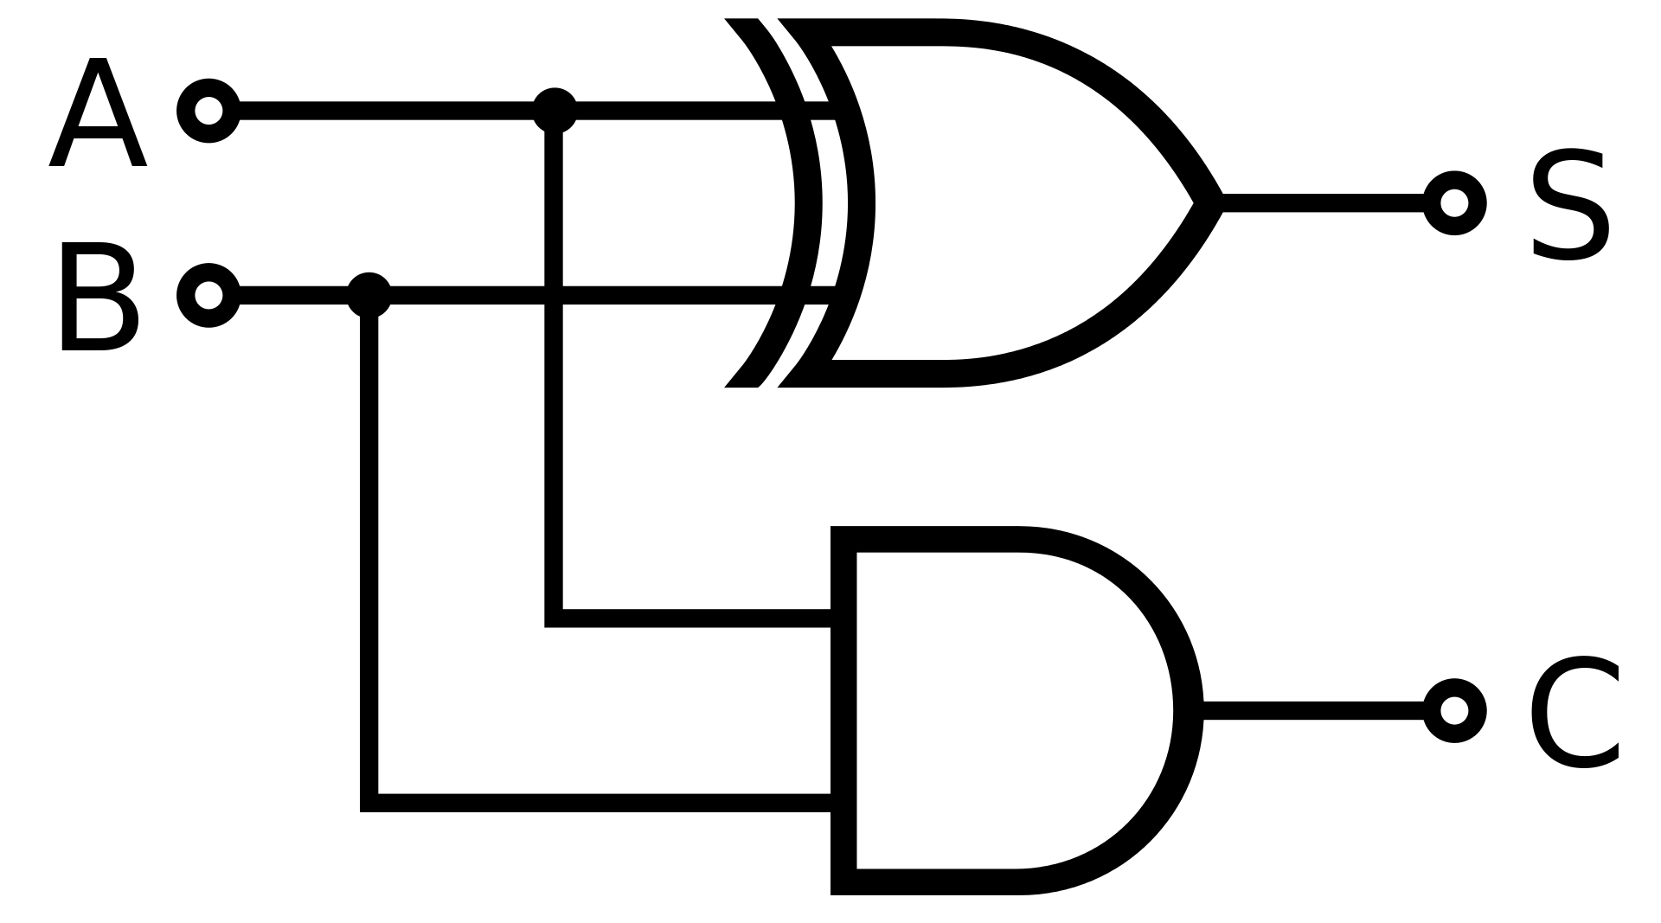
Objective: We will simulate a half-adder circuit using structural VHDL in ModelSim
Things we have to look for:
Components of the circuit ( in this case and gate, xor gate would be our component)
Fig: Half-Adder circuit

Slide 4
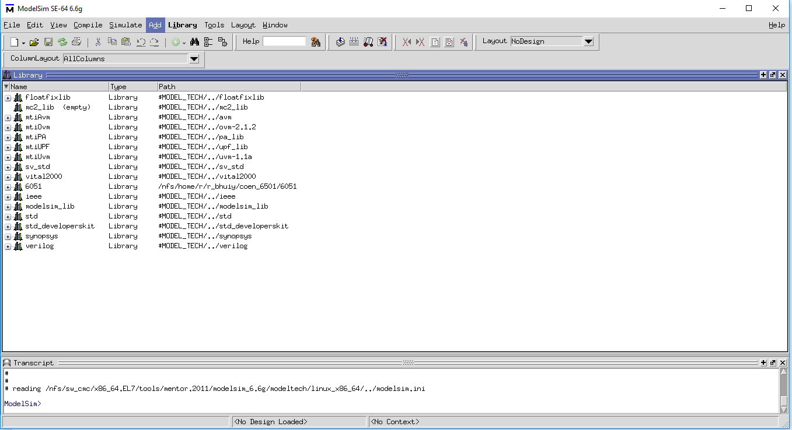
Start ModelSim on your computer

Slide 5
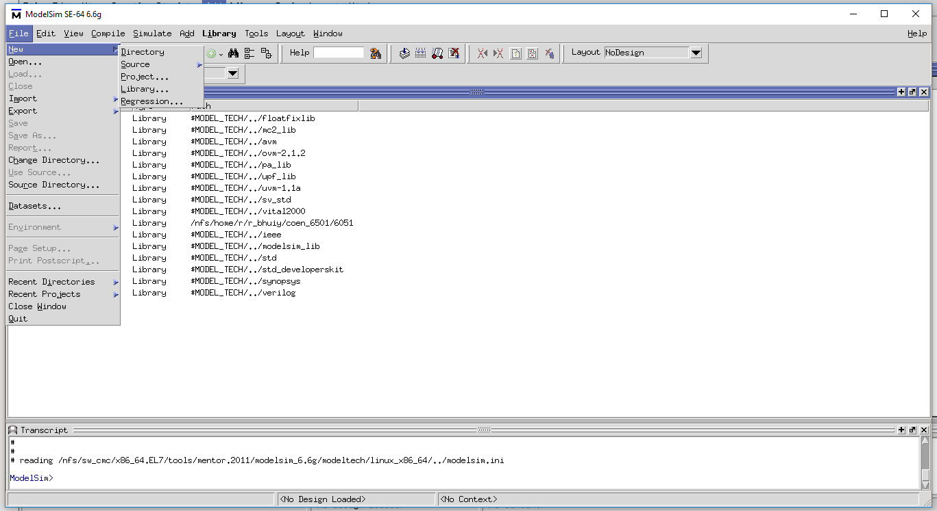
Go to file menu
Move your cursor to New
Select project…

Slide 6
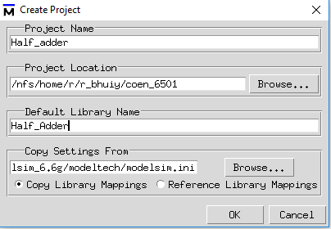
This window will pop up.
Fill Project Name
Fill Library name if you want to change
the name or it can be kept as work by default
Click OK

Slide 7
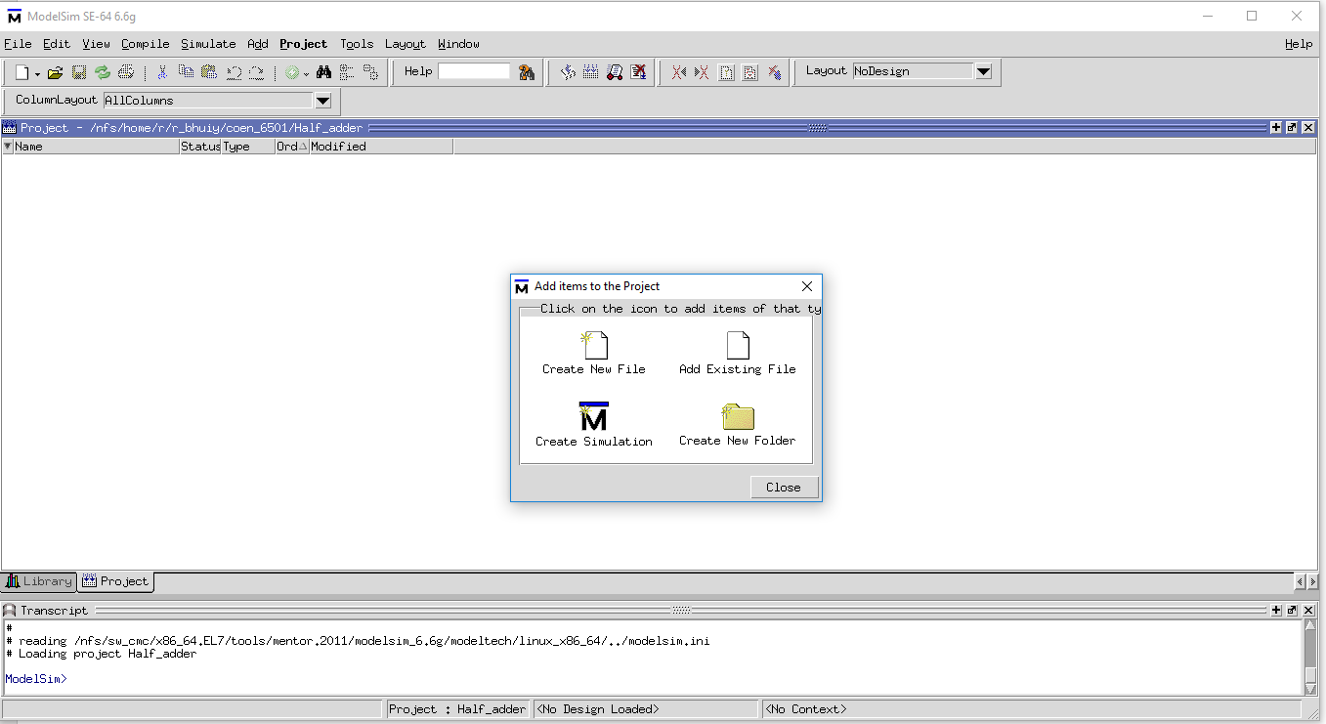
Click Create New File
If you have the files
already then click on
Add Existing File
and select the directory
or files you want to add

Slide 8
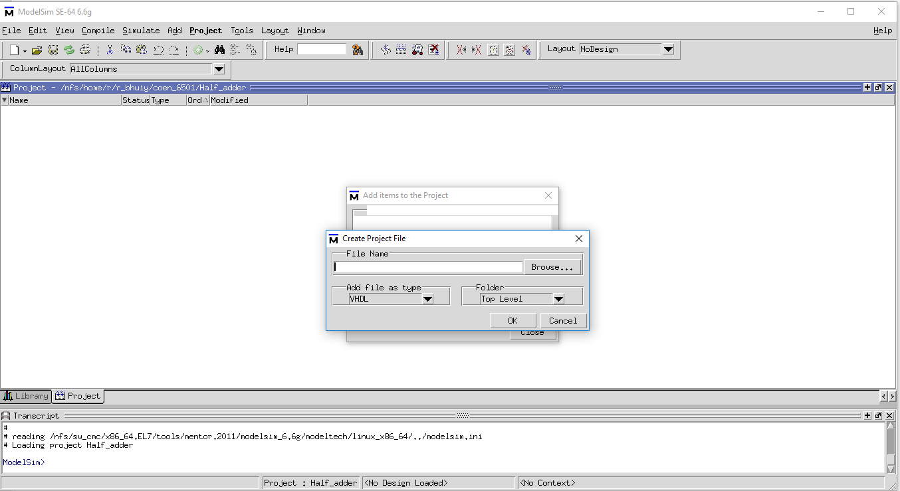
Put File Name
Click OK

Slide 9
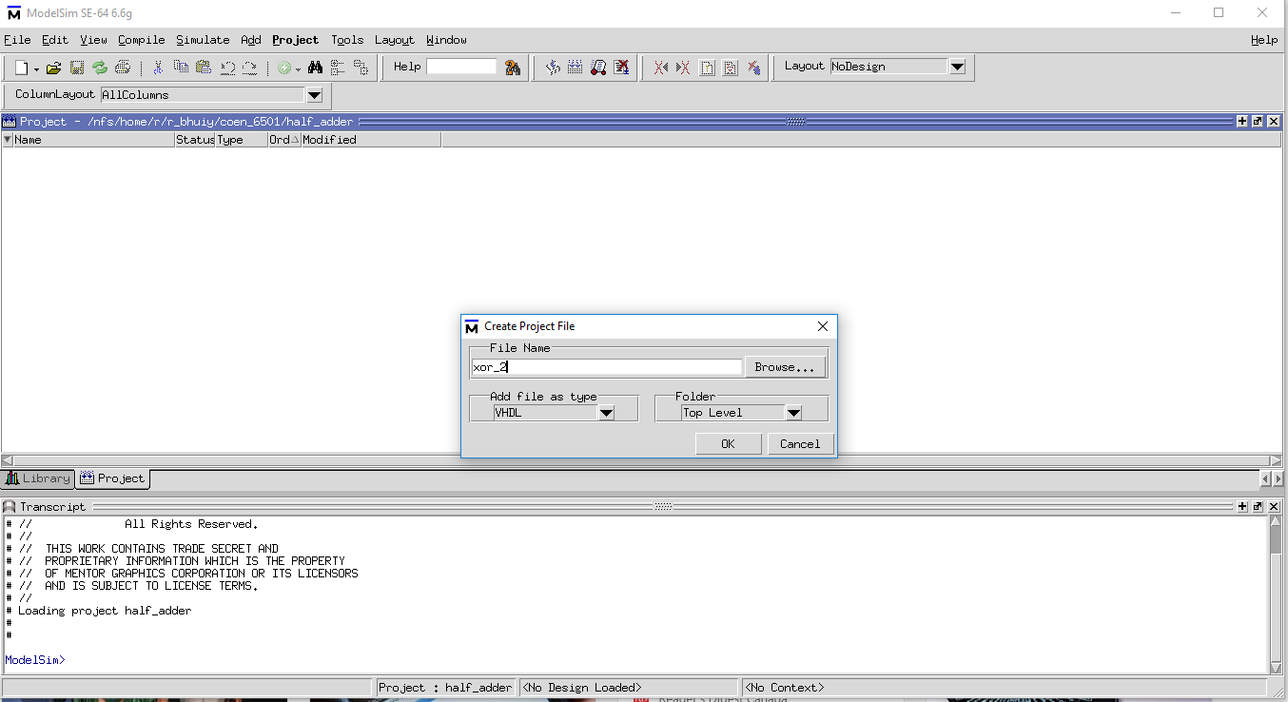
I am adding a Xor gate to
project as I am building a half adder which has xor gate as component
**avoid naming file as xor,and,or only as they are library functions. We can use
And_1,xor_2 as names

Slide 10
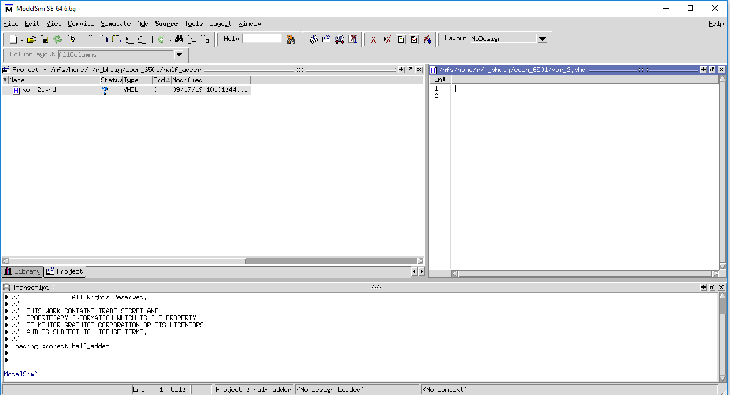
If you click twice on the file then
a notepad will show up in the right
where we have to write the code
Write your code here

Slide 11
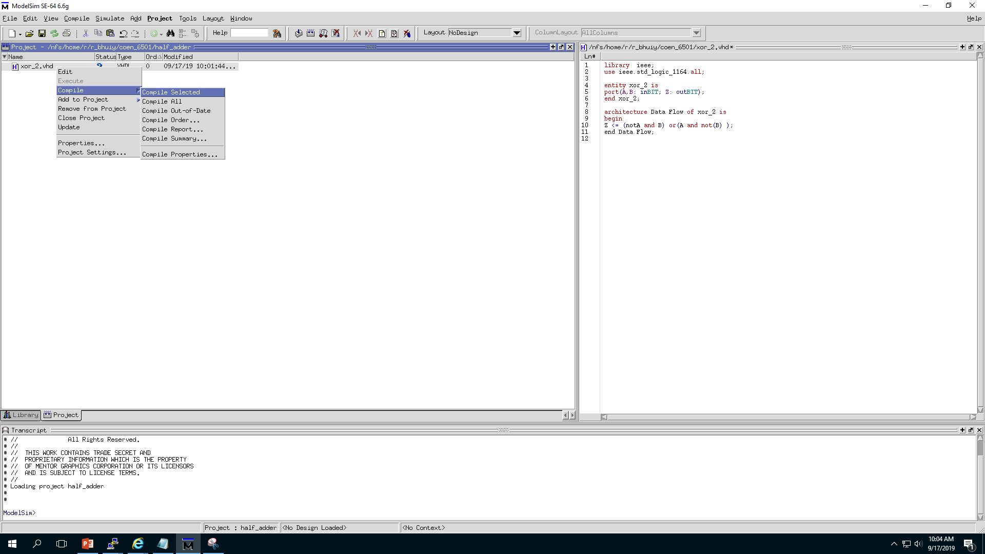
Can click on this icon to compile
or
You can right click on file name
And select “compile Selected” option

Slide 12
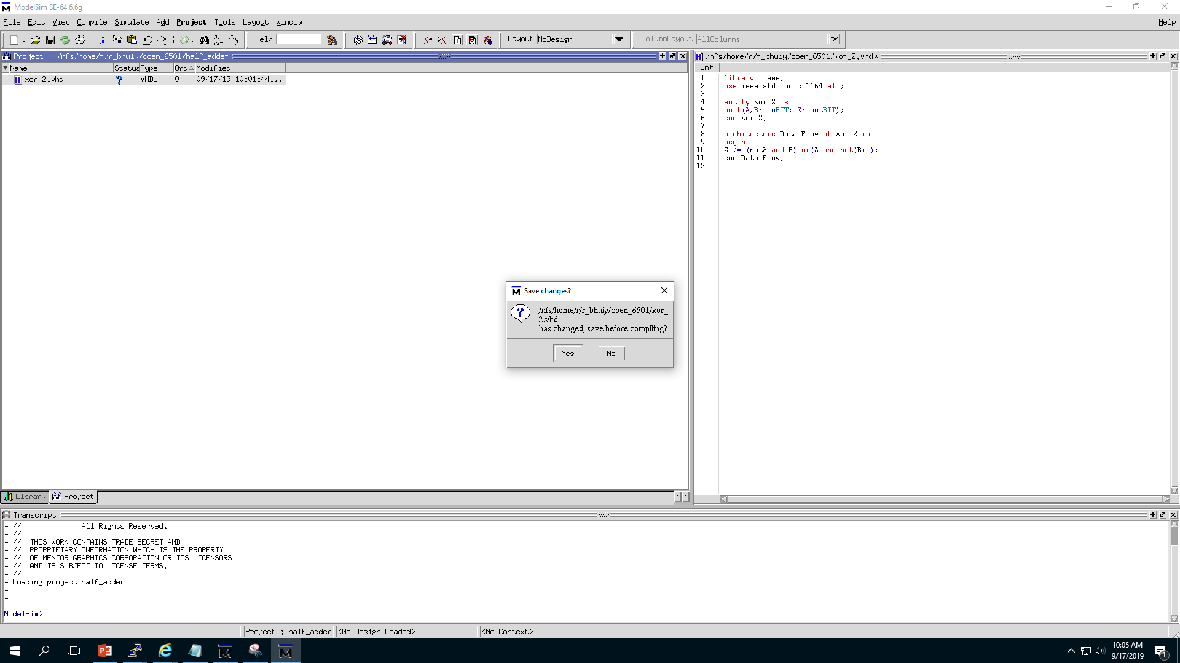
If you haven’t saved the file you will get this window to save your changes before compiling.
It is a good practice to save the file after every change.
Click Yes

Slide 13
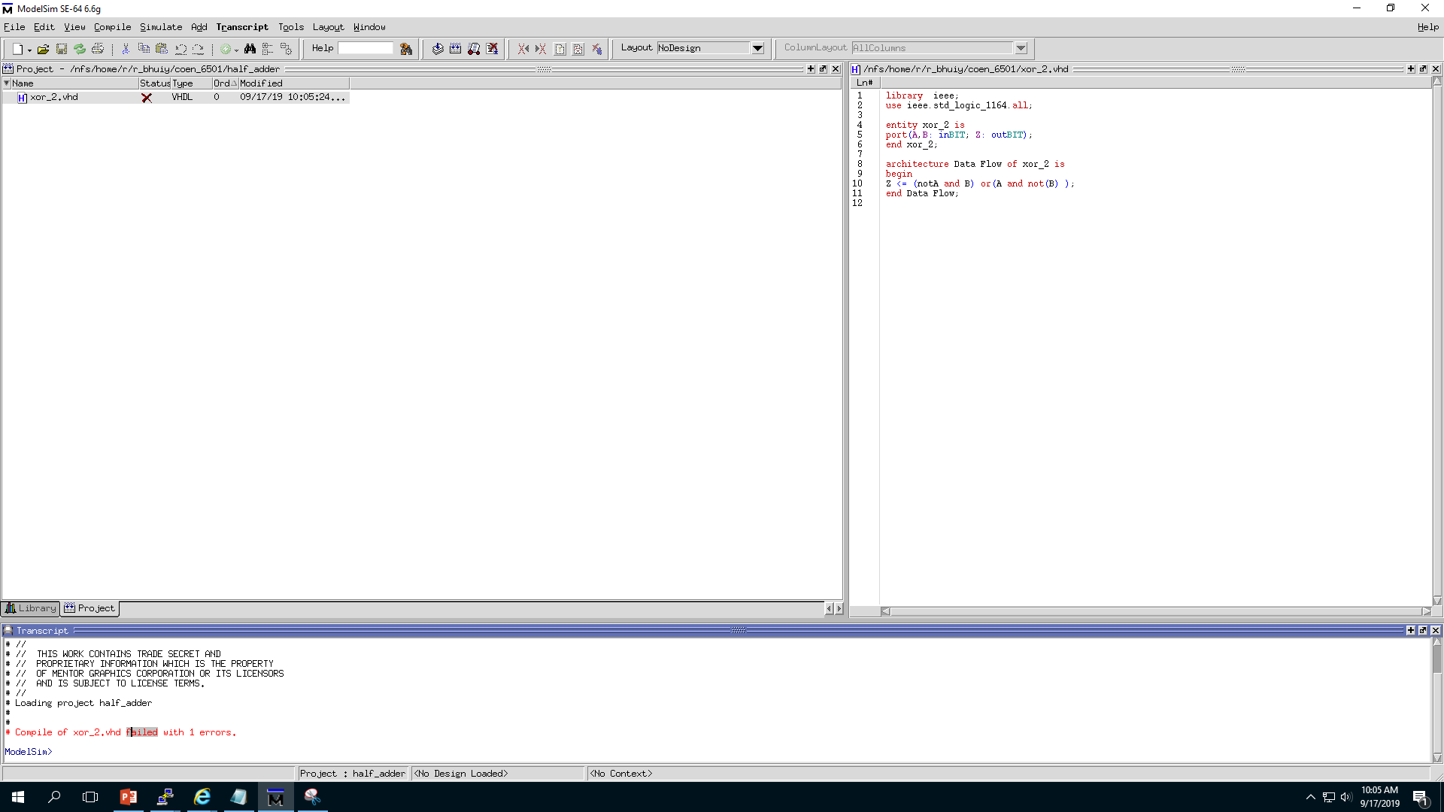
We have some errors in code.
So, the compiler could not compile.
Click on this line twice to see errors in code

Slide 14
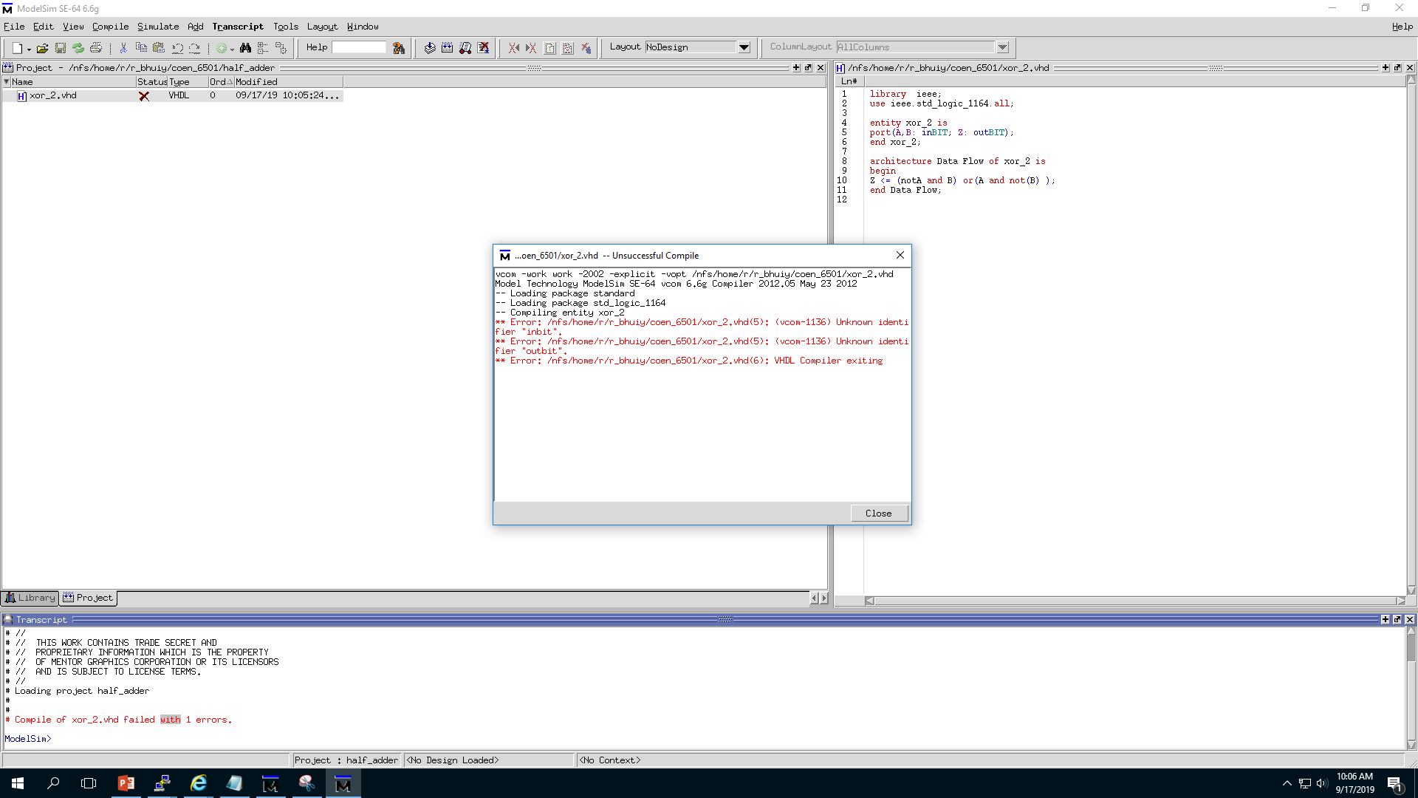
Here you can see the list of errors

Slide 15
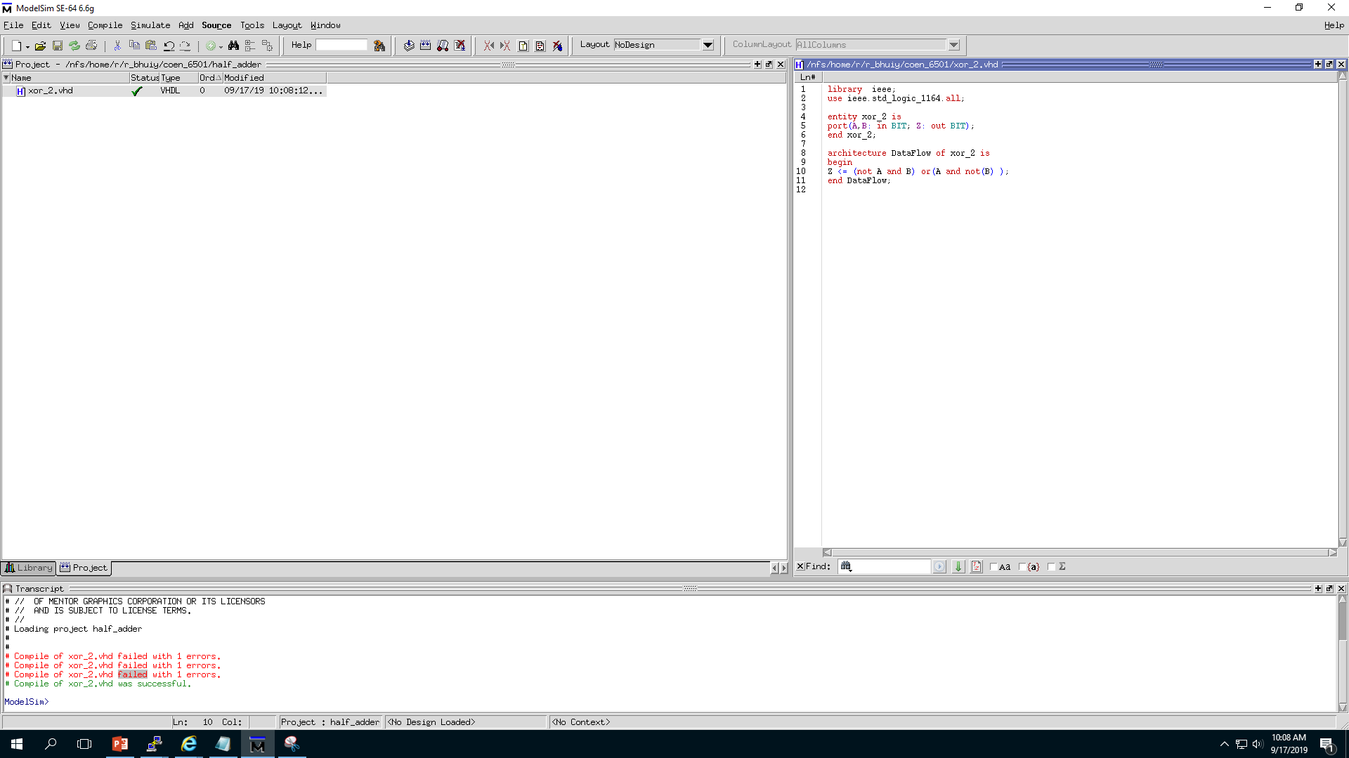
Status
Correct them and compile again.
You will get successful message in your
Transcript window and also a green tick mark in status.
Transcript

Slide 16
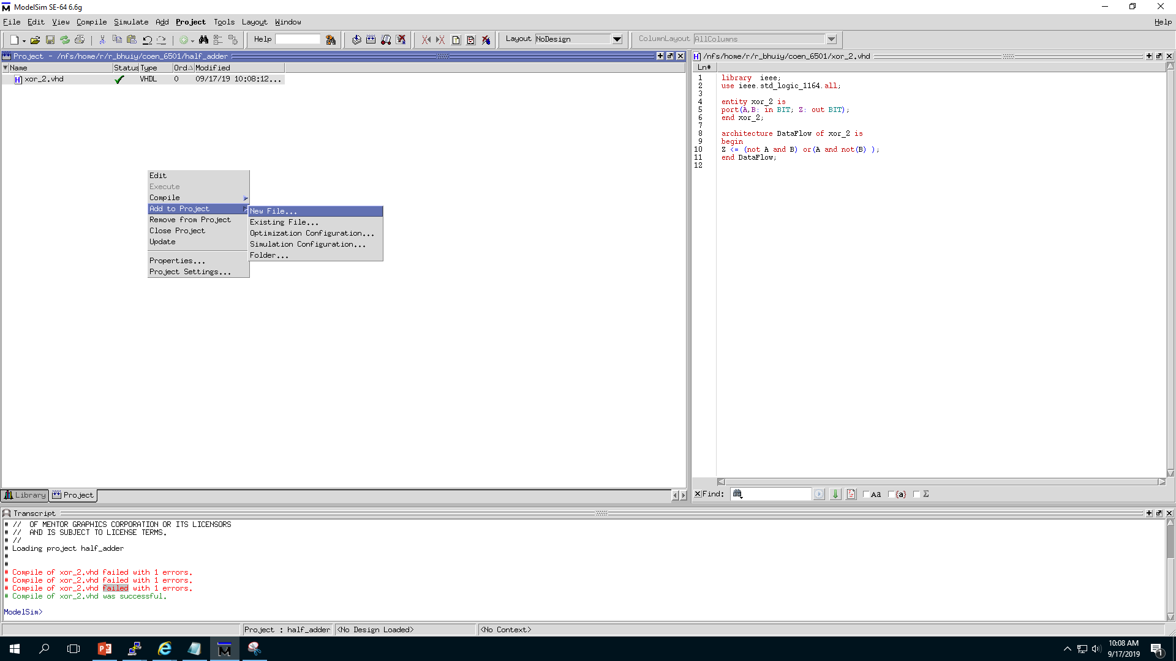
Now we are going to add component and gate
along with main file Half adder.
You can also use this button to add new file
Right Click here in blank space and select “Add to project” and then “New File…” or “Existing File”

Slide 17
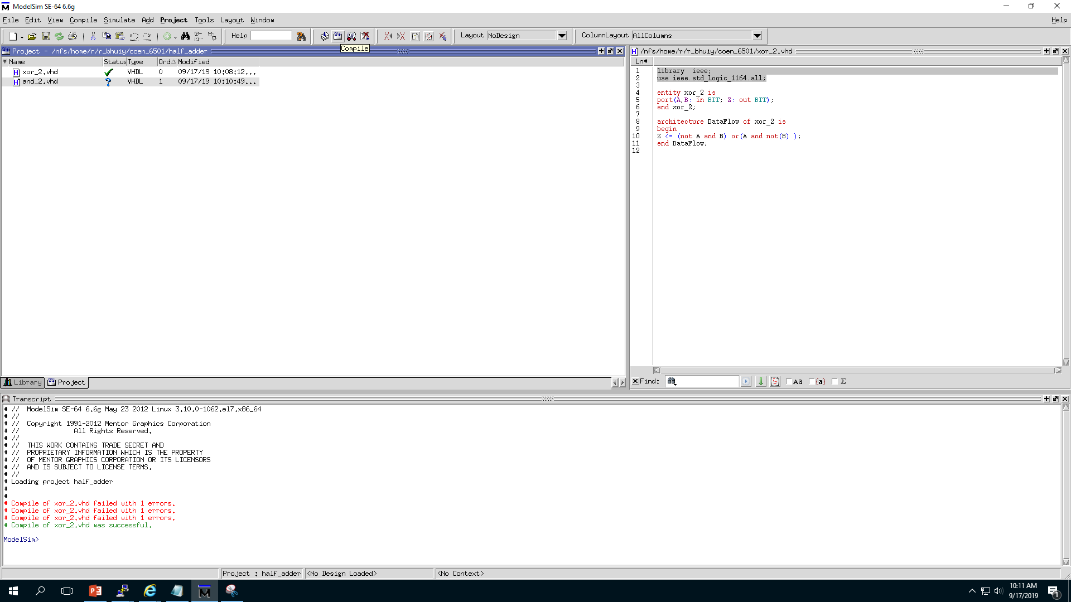
We have added and gate following the same procedure for xor gate

Slide 18
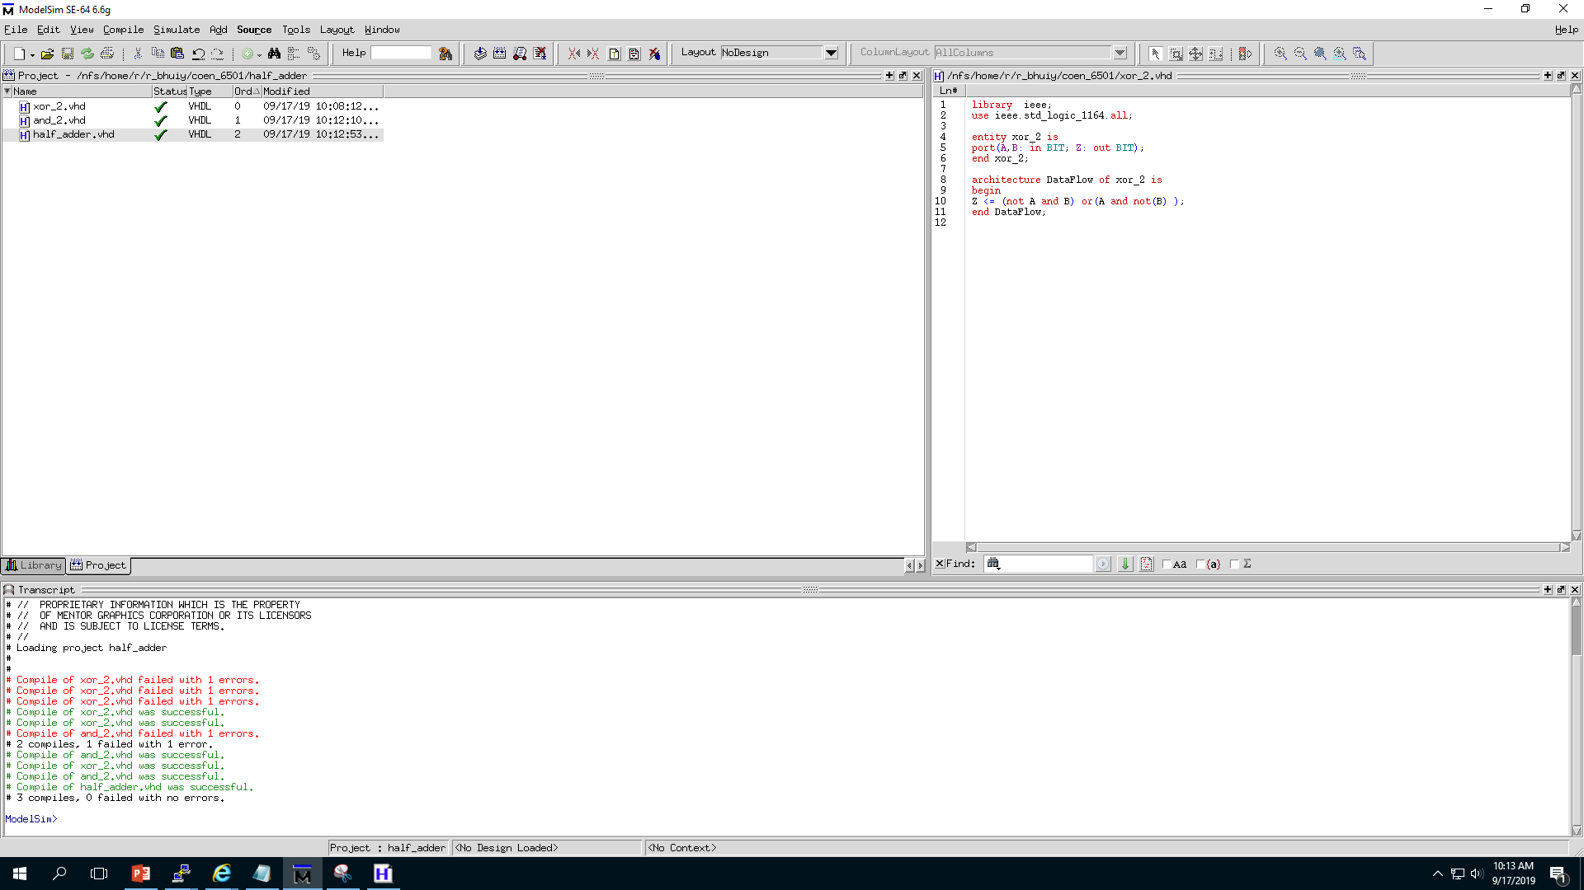
You can use this button to compile all files in project or follow the procedure how you have compiled xor_2 file . Just select “compile all” option.
We have added half adder file and compile all

Slide 19
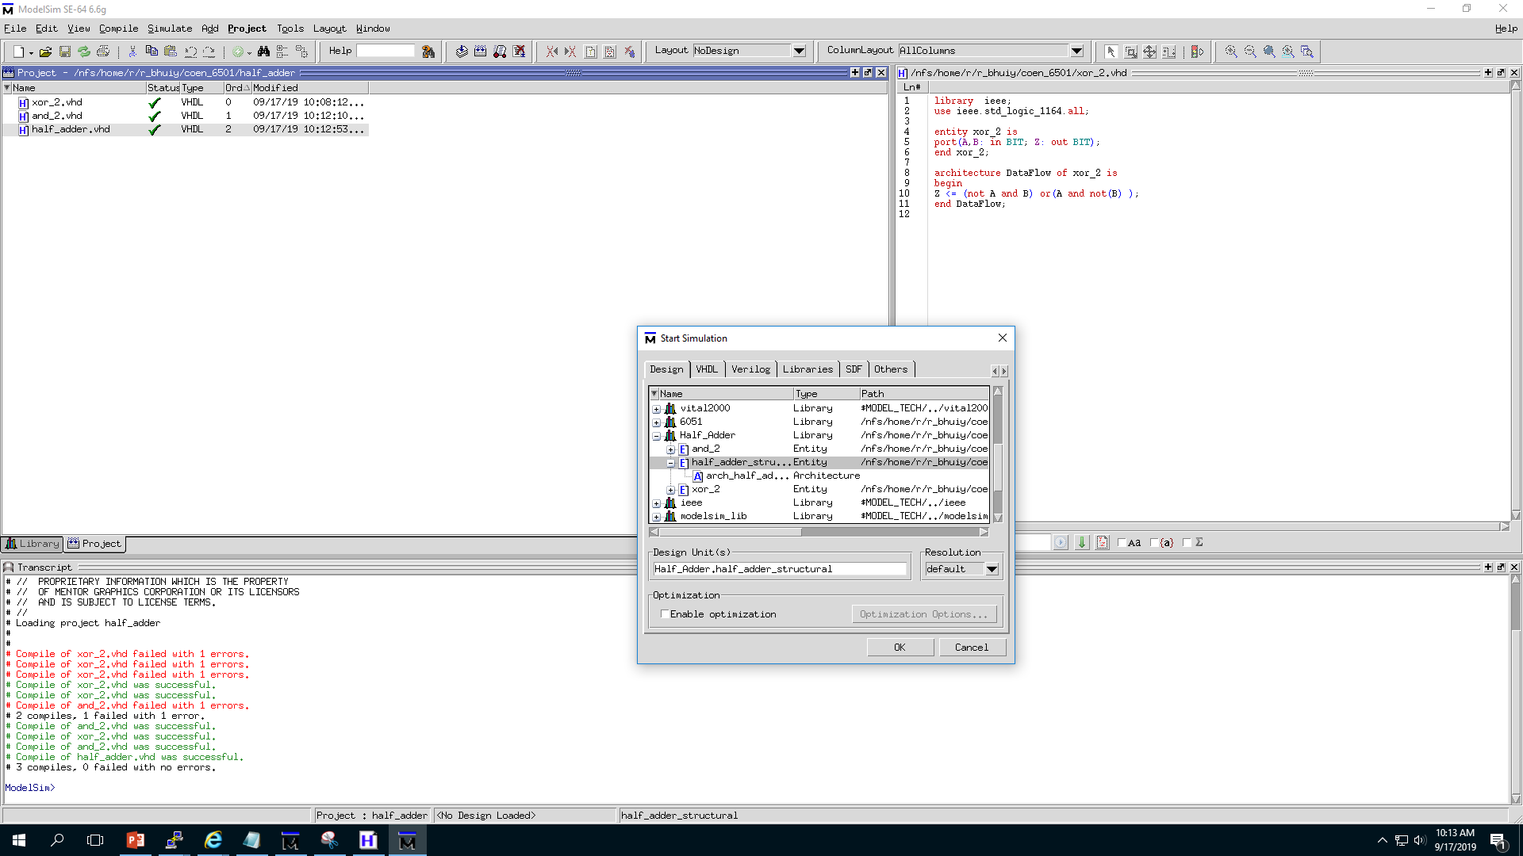
Click on this one to go to Start simulation window
You can also use Simulate
To go to Start simulation window
1.Expand the library
2. Choose the file you want to simulate and click OK

Slide 20
Alternative method to simulate or page 18 is in next page

Slide 21
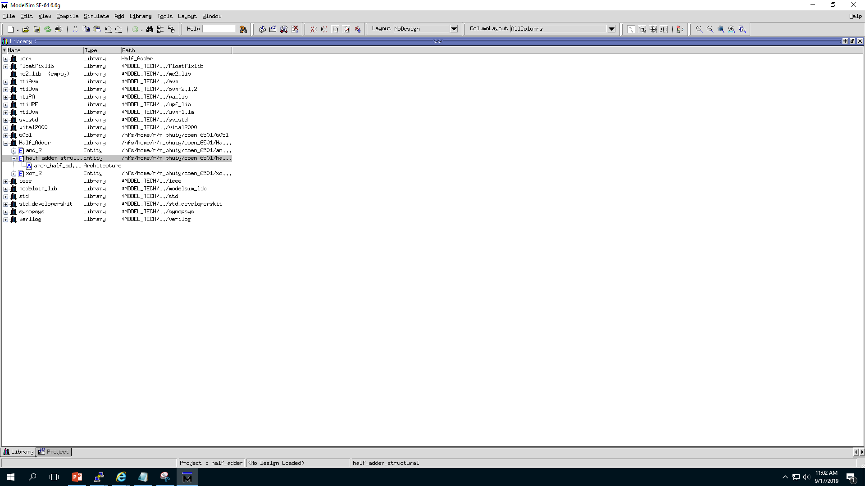
2. Select the file and double click
1. Click here to open library directly

Slide 22
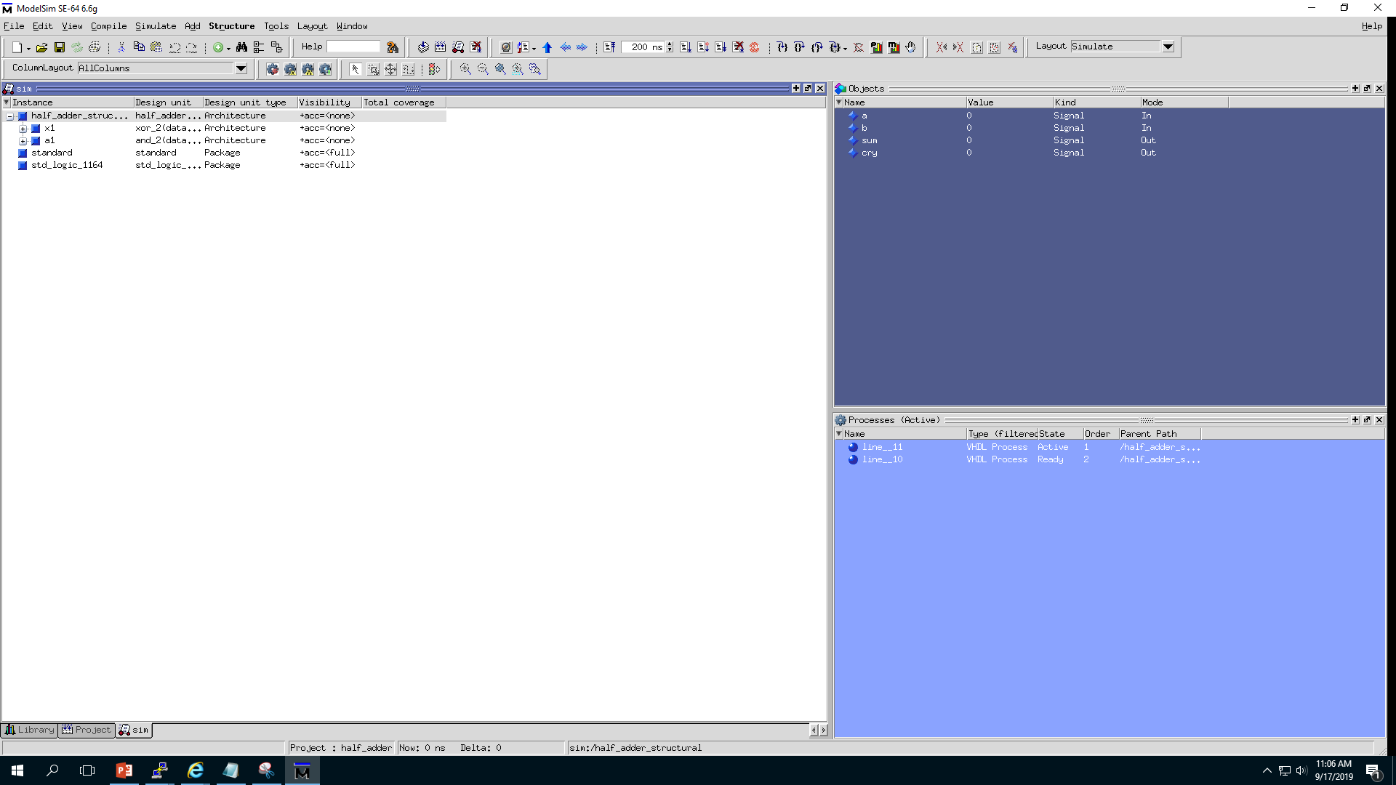
You can see input output of the design
This window will pop-up

Slide 23
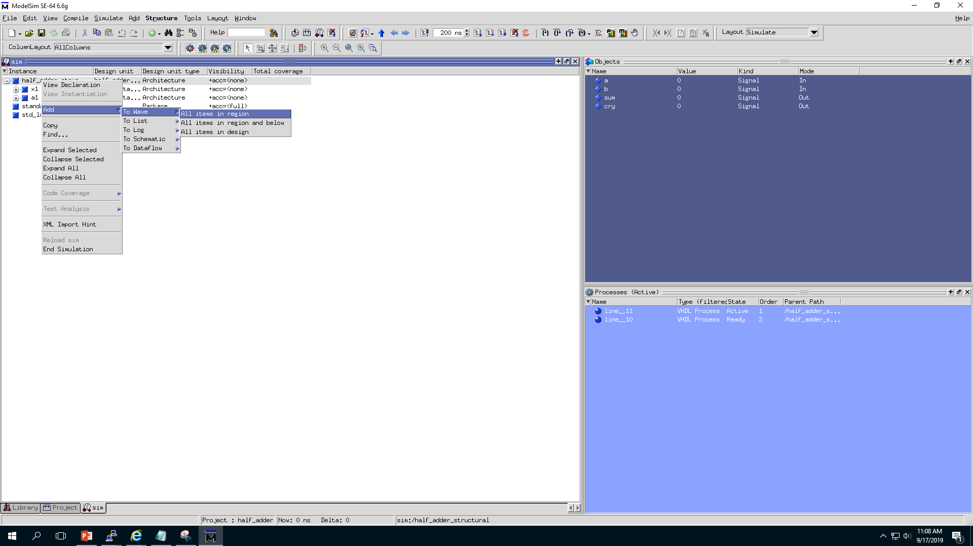
1.Right click on the file name “half_adder_structural”
2.Add
3. To wave
4.All items in region
Now we have added all the input and outputs in the waveshape

Slide 24
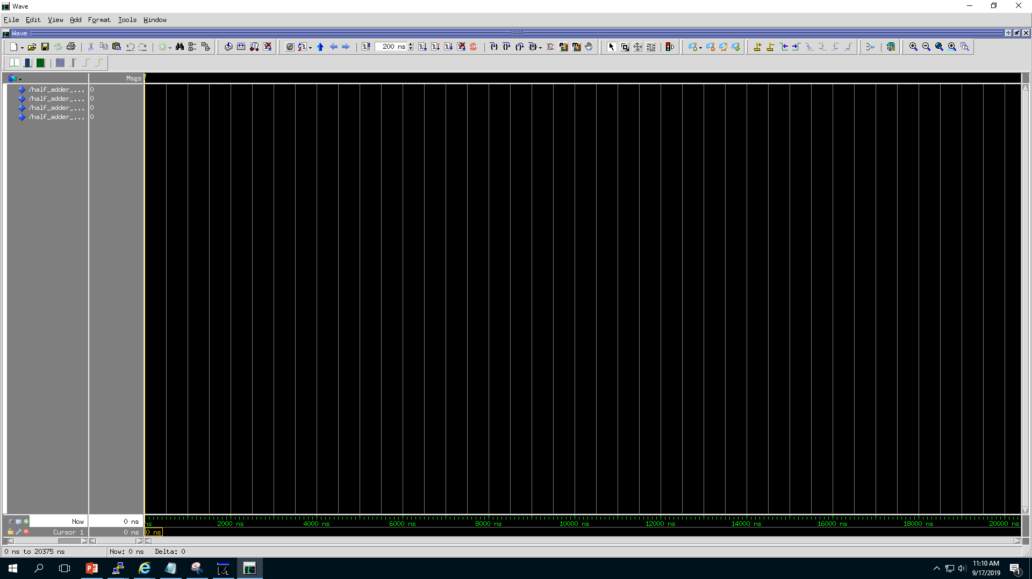
This one run the simulation for all the test cases if you have a testbench.
This one is the simulation time. You can change it
This one will run the simulation for specified time cycle such as 200ns which is written in simulation time.

Slide 25
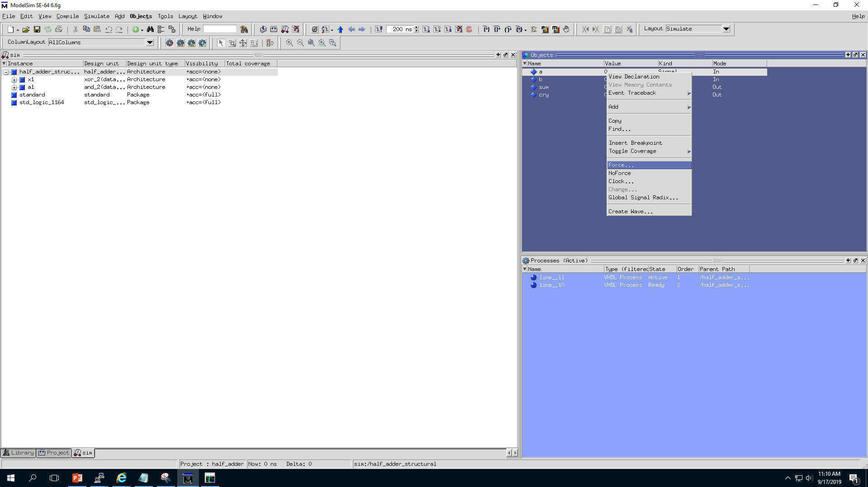
Right Click here on “0” to get this options
Now we would give some input values to see output using “Force..” option

Slide 26
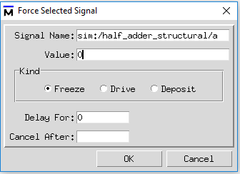
Change the value. I am changing it to “1”.
Press OK

Slide 27
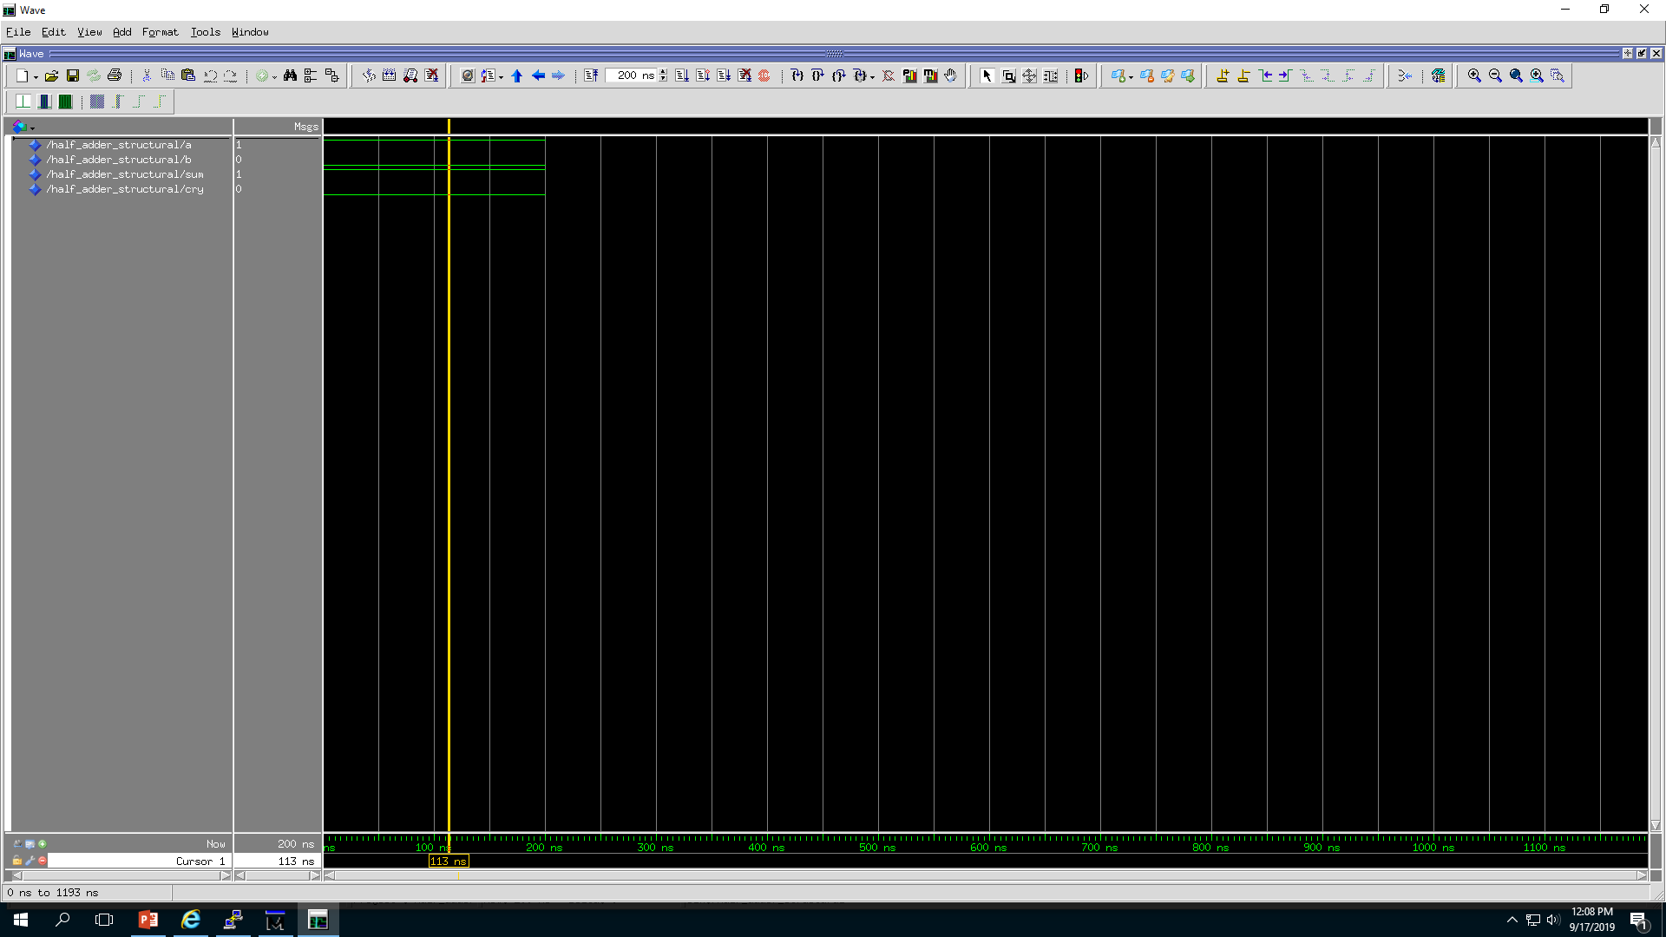
Input and outputs
Current value on 113 ns
So I have forced value of a to be 1 and value of b to be 0. Then I run it for 200ns .
We can see that the output we got are sum=1 and cry=0.

Slide 28
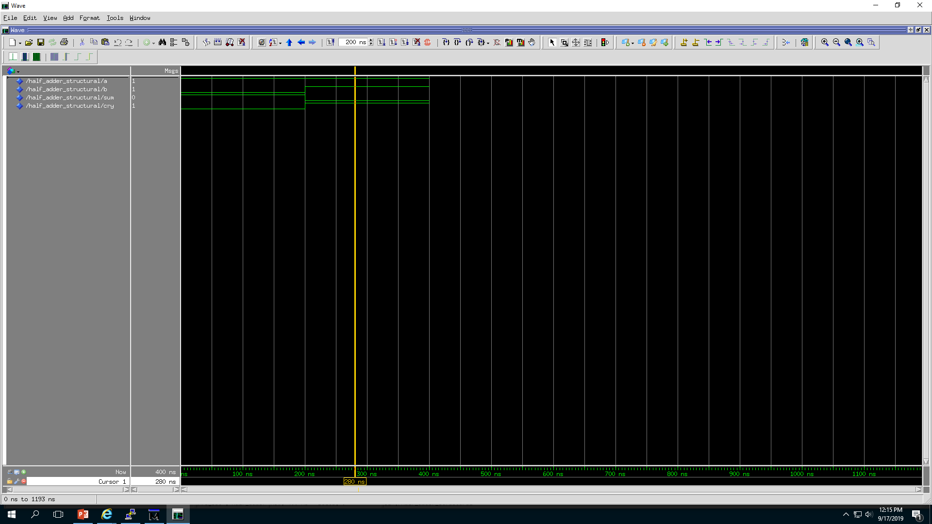
So I have forced value of a to be 1 and value of b to be 1. Then I run it for 200ns .which will start from 201 ns and finish at 400ns.
We can see that the output we got are sum=0 and cry=1 for that cycle.
So it is supporting truth table of half adder circuit
Click anywhere in this space to see the input output values for that time.

Slide 29
Further Reading: How to use testbench to simulate half adder circuit
Contact: rokibulhasan@iut-dhaka.edu
Ref:
1. https://users.encs.concordia.ca/~asim/COEN_6501/Lecture_Notes/L7_Slides.pdf
2. https://upload.wikimedia.org/wikipedia/commons/thumb/d/d9/Half_Adder.svg/1920px-Half_Adder.svg.png

